Slide 1
Document Search Engine
Comprehensive explanation of the Document Search Engine

Slide 2

Introduction
The Document Search Engine allows users to upload documents and perform efficient searches using various retrieval models.
Results are presented with matching filenames and content snippets, ranked by relevance.

Slide 3
Overview
The Document Search Engine is a Flask application built using Python.
It enables users to upload and process documents, apply advanced search algorithms, and retrieve results ranked by relevance.
The engine incorporates two primary models for search: the Belief Network and Interference Models.

Slide 4
Search Models: Interference Model
The Interference Model is like being a detective searching for clues. Imagine you’re trying to find which book in a library talks the most about "dinosaurs."
Step 1: You check how many times the word "dinosaur" appears in each book (this is called term frequency).
Step 2: You give more importance to books that have the word more often and in more important places (like the title).
Step 3: You make a list of books from the best match to the least match.

Slide 5

Search Models: Interference Model
Key Features:
Tokenizes and preprocesses the query and documents.
Calculates term frequency for each document.
Computes probabilities for query-document pairs.
Ranks documents based on their relevance probabilities.

Slide 6
Search Models: Belief Network
A Belief Network is like a thinking machine that helps us make decisions when we don’t know everything. Imagine you're playing a guessing game about what your friend wants to eat.
Step 1: You know your friend loves pizza, but they also sometimes like burgers or pasta.
Step 2: You look at clues, like what they ate yesterday or if they mentioned liking cheese.
Step 3: Based on the clues, you guess that they probably want pizza today.

Slide 7
Search Models: Belief Network
Key Features:
Tokenizes and preprocesses the query and documents.
Computes query-document match ratio.
Calculates joint and marginal probabilities.
Uses Bayes' theorem to compute posterior probabilities.
Ranks documents based on their posterior probabilities.

Slide 8
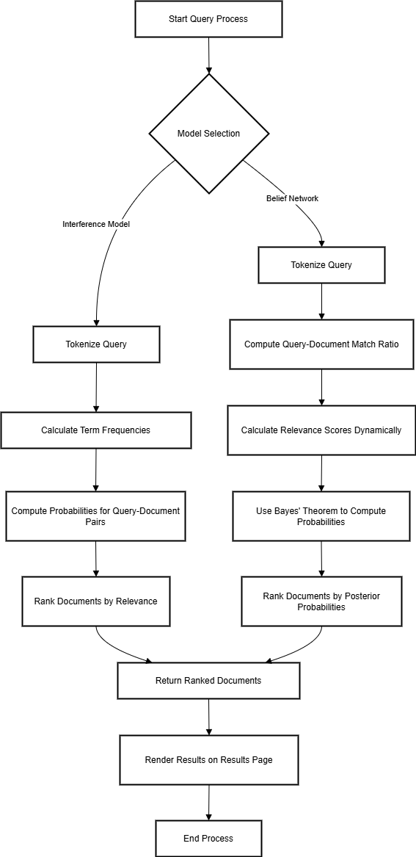
DFD

Slide 9
DFD Explanation
User Input: The user provides a query.
Query Tokenization: The query is broken down into individual terms.
Model Selection: A suitable retrieval model is chosen.
Term Frequency Calculation: The frequency of terms in the query and documents is calculated.
Query-Document Matching: The query is compared with each document to determine relevance.
Relevance Score Calculation: Documents are assigned scores based on their match with the query.
Document Ranking: Documents are ranked based on their relevance scores.
Result Display: The top-ranked documents are presented to the user.

Slide 10
Technical Details
• Programming Language: Python
• Framework: Flash
• Search Algorithms: Belief Network,
Interference Modal
• Data Storage: Files in documents/ directory, indexed in a dictionary.

Slide 11
Future Improvements
• Integrate machine learning models for enhanced semantic search.
• Add support for additional file formats (PDF, Word).
• User-friendly front-end with advanced filters and pagination.

